Slide 1
Machine Learning in Finance
Elliot Noma, PhD
Elliot.noma@Rutgers.edu
Rutgers Masters in Mathematical Finance
Fall 2024. Week 2

Slide 2
Financial modeling
Focus is often on either
Improving returns
Asset allocation
Security selection
Trade timing and execution
Reducing risk
Hedging strategies
Avoiding tail risk
Buying or selling insurance

Slide 3
Model refinement
Get data
Data cleaning
Model selection
Train model
Model valuation
Factor mapping

Slide 4
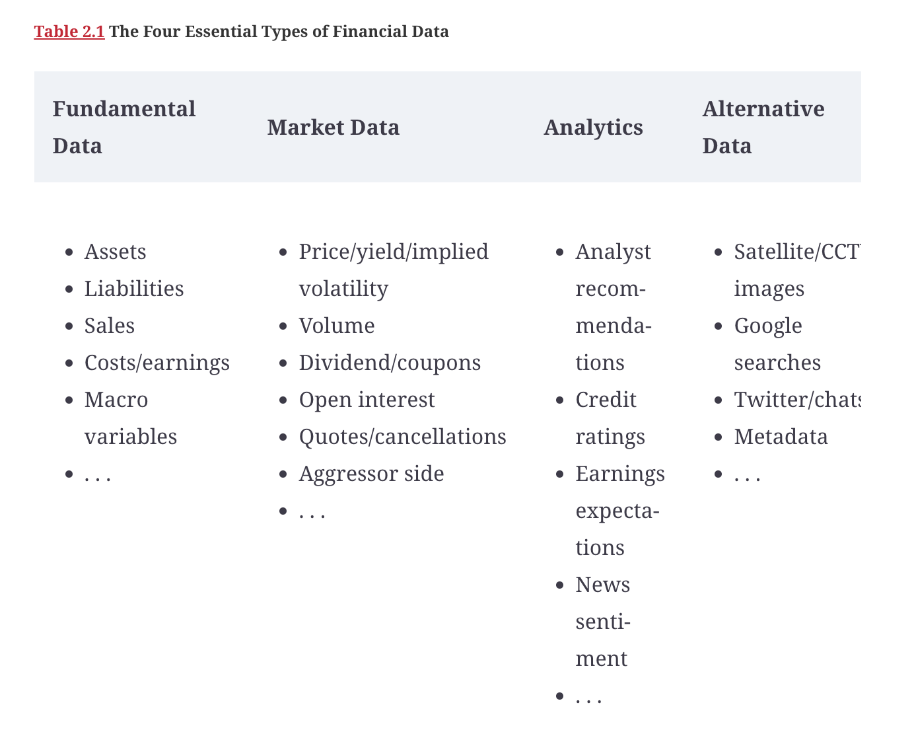
Data sources

Slide 5
Computing Returns

Slide 6
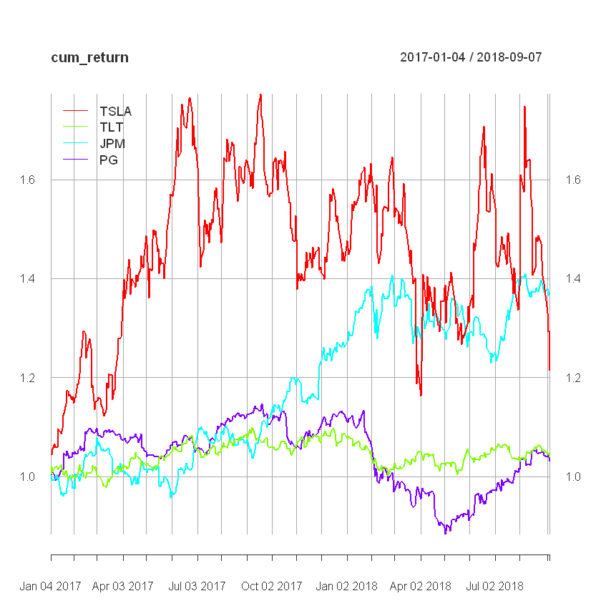

Slide 7
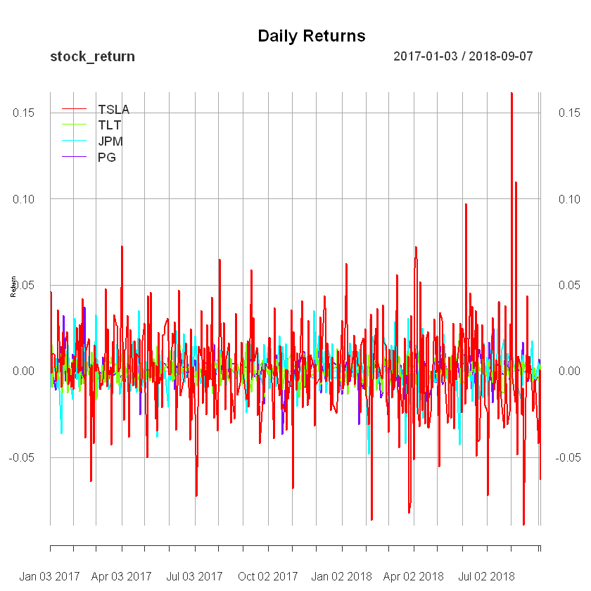

Slide 8
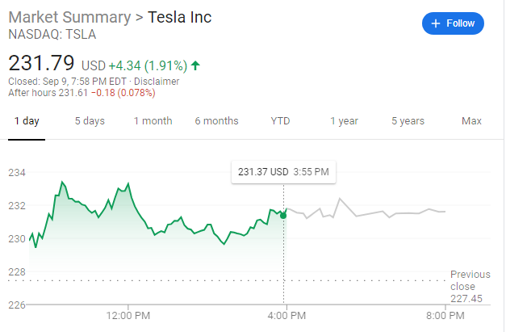
What is the main driver of price movement?
Trading is the main driver of prices
Also called noise trading: see Trading Places https://www.youtube.com/watch?v=RLySXTIBS3c

Slide 9
Return calculations
 | Period | Cumulative
Arithmetic
Geometric
$r_{T}=\prod_{t=1}^{T}{\left(1+r_{t}\right)}$-1
$$R_{T}=\sum_{t=1}^{T}{R_{t}}$$

Slide 10
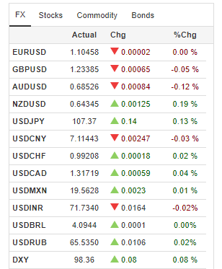
Arithmetic vs. Geometric Returns
Similar over small price changes
Ln(x)=(x-1)+ ½*(x-1)^2+1/3*(x-1)^3+…
Advantages of geometric calculations
Prices are always positive
Symmetric return calculations when trading across currencies regardless of how they are quoted in USD per Yen or Yen per USD
Multiperiod calculations are the sum of the log returns for the individual periods

Slide 11
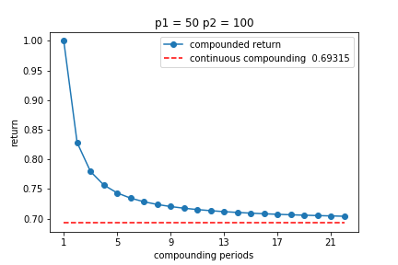
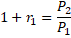
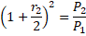
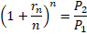
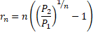
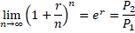
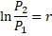
Compounded returns
Single period
period
Multi period
Limit

Slide 12
Traditional algorithm trading
Technical trading: Trend following
If the price is going up, it will continue to go up
If the price is going down, it will continue to go down
Classic trending following strategy
Compute 200 day moving average of prices
Compute 50 day moving average of prices
Buy signal: the 50 day average crosses above the 200 day average
Sell signal: the 50 day average crosses below the 200 day average

Slide 13
Strategy Envelope
Terminate Strategy
Stay in Strategy
Share Price
Terminate Strategy
Terminate Strategy
Time

Slide 14
Backtesting the Moving Average Strategy

Slide 15
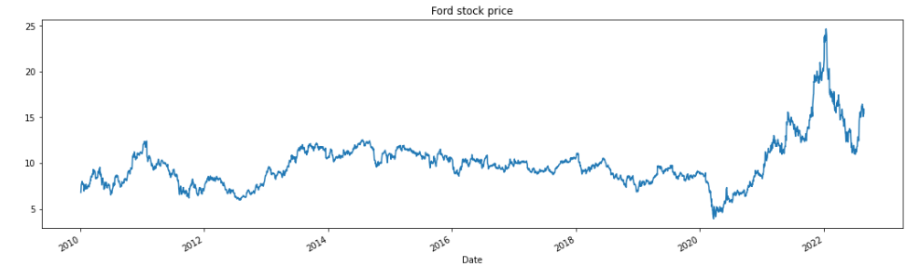
Ford prices

Slide 16
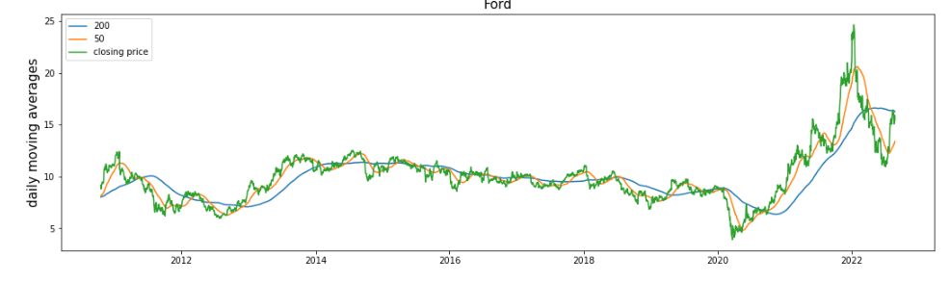
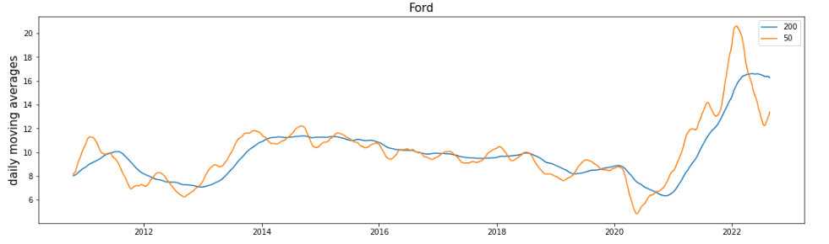
50 and 200 day moving average prices

Slide 17
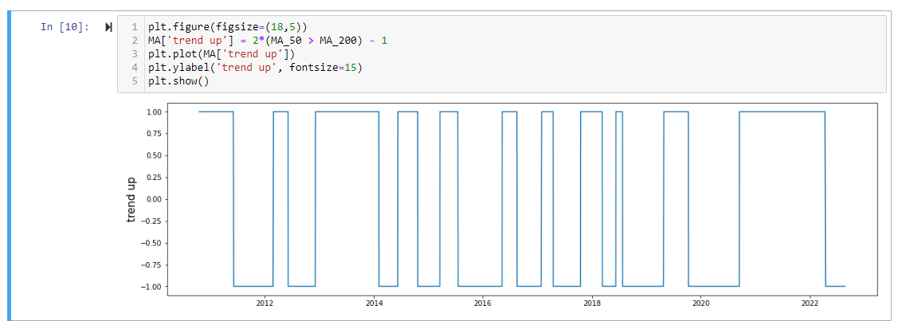
Long or short position

Slide 18
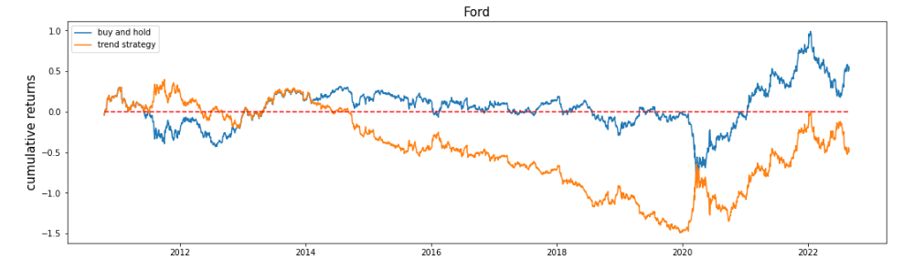
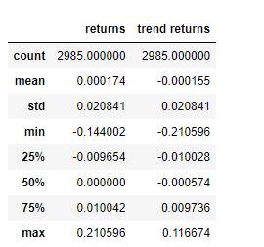
Buy and hold vs trend following

Slide 19
Optimizing a linear model strategy
Ford motor company returns
Model predicts returns for the next 5 days
Inputs
Today’s return
Return over past 5 days
Moving average historical returns

Slide 20
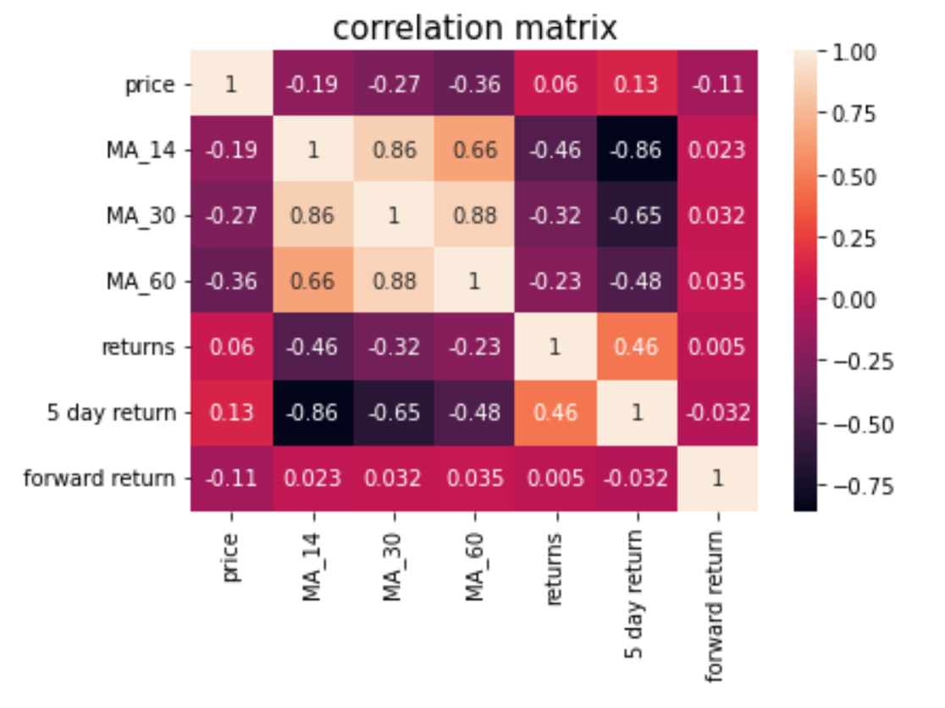
Input variables

Slide 21
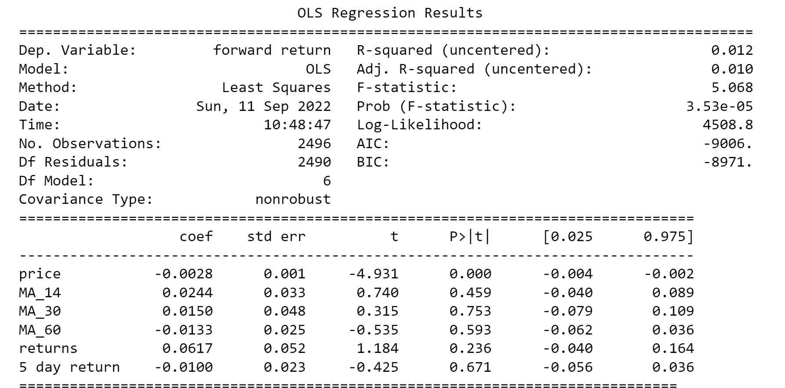
Model parameters

Slide 22
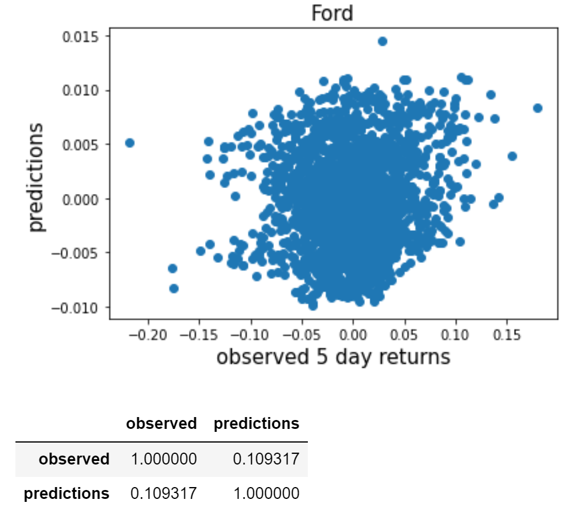
Prediction vs observed returns

Slide 23
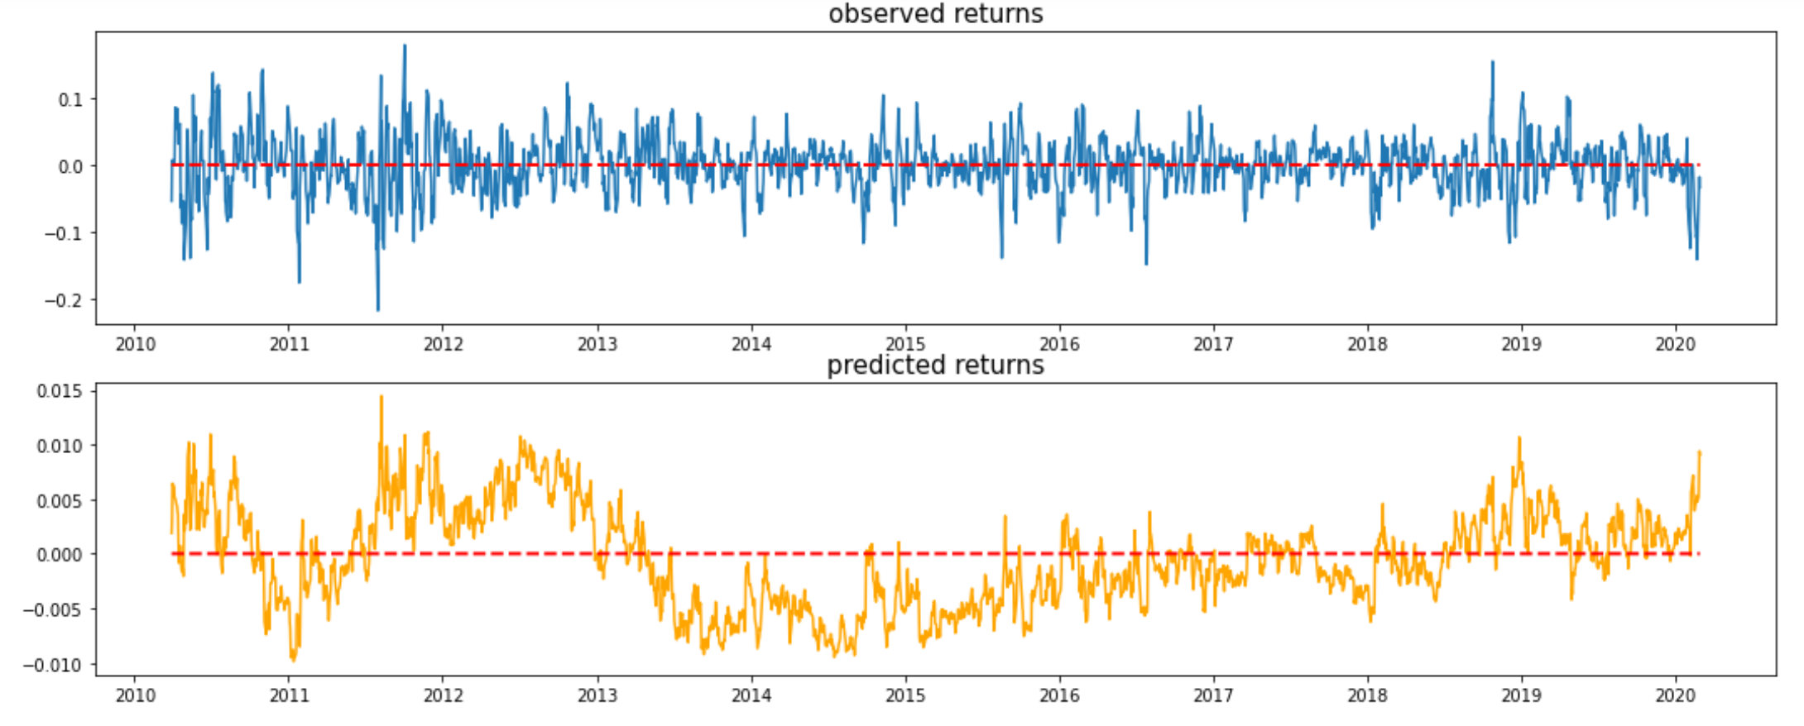
Observed vs predicted returns

Slide 24
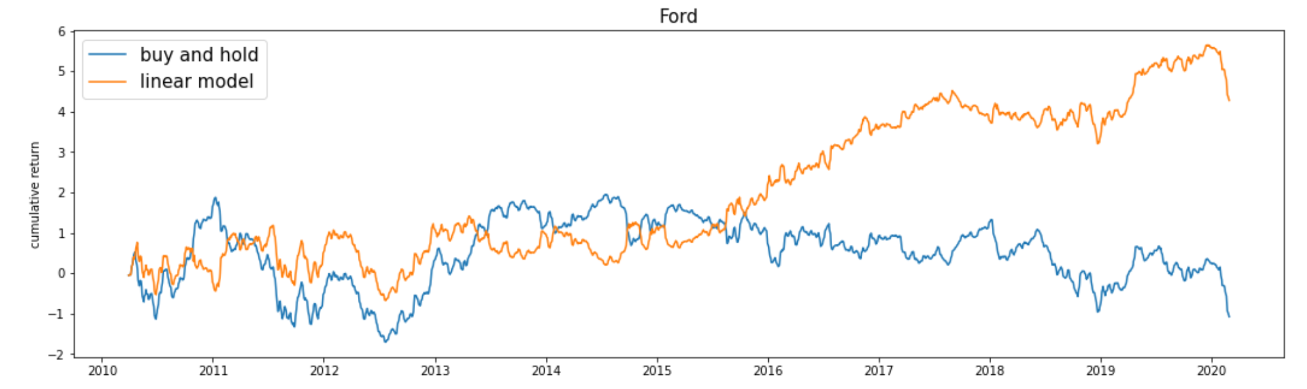
Cumulative strategy returns
Long position when predicting a positive return and short when predicting a negative return

Slide 25
Is that it for creating a success strategy?
What have we assumed when assembling this strategy?
What are the strategy limitations?
Do we need to do further testing?

Slide 26
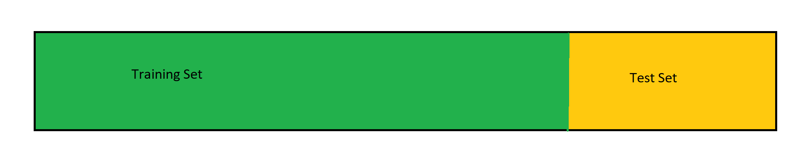
Model training design
Often use a 80-20 split between training and test sets

Slide 27
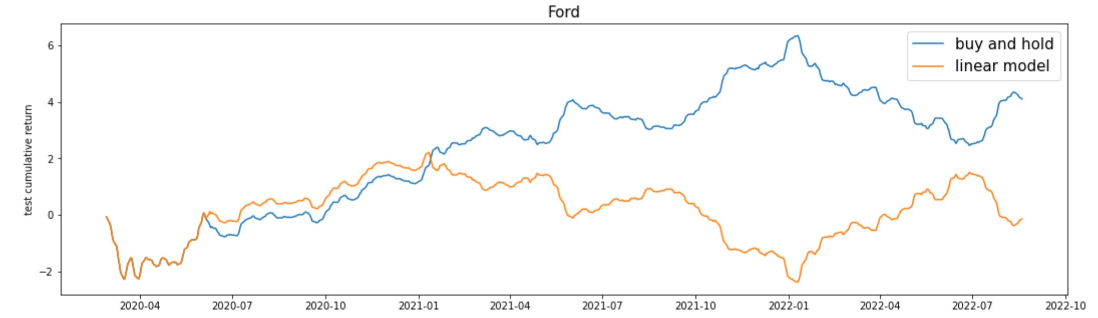
Performance on test set

Slide 28
Model evaluation metrics
Data science metrics
Least square minimizations
Accuracy
Fitting to a probability distribution
Area under curve
Business metrics
Profitability
Time savings
Risk reduction

Slide 29
Evaluating a model: an example

Slide 30
Why volatility is equated with risk
Humans prefer certainty over uncertainty
$100 for sure vs coin flip $200 or $0
Risk aversion
Losses hurt more than gains
Regret results if we lose rather than take a sure thing
Uncertainty avoidance is similar to risk, but not the same
$100 for sure versus any value from $0 to $200
Certainty permits planning

Slide 31
Volatility
Volatility =the standard deviation of the daily returns
$$volatility=\sqrt{\frac{1}{T}\sum_{t=1}^{T}{{\left(r_{t}−\overline{r}\right)}^{2}}}$$
However the daily returns are small relative to the standard deviation (not statistically significantly different from zero)
so $r_{t}^{2}$ is the one-day estimate of volatilty
Volatility over a time period is usually written as
$$volatility=\sqrt{\frac{1}{T}\sum_{t=1}^{T}{r_{t}^{2}}}$$

Slide 32
How to actually compute volatility
Volatility is computed so we can predict the future paths of prices
We care about historical returns, but
We don’t really care about volatility in the past
If we use historical data to predict future volatility, it’s important that we specify the time period over which volatility is computed

Slide 33
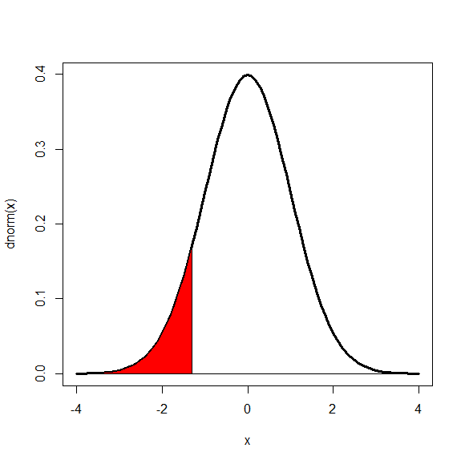

Slide 34
Tail distribution statistics
Normal n(0,1)
from scipy.stats import norm
norm.ppf([0.95, 0.99, 0.975])
 | critical value
(VaR, 5% one tailed) | 1.645
(VaR, 1% one tailed) | 2.326
(testing, 5% two tailed) | 1.960

Slide 35
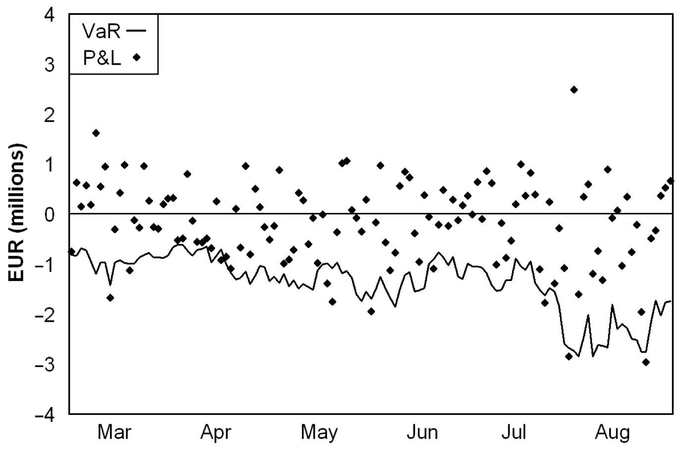
Violation counts
Actual = 9
Expected = 0.05 * 120 = 6
Sdev =
z = 1.26

Slide 36
Likelihood of winning 3 games, p=40%
To compute the likelihood
count the number of way to have a sequence of 3 wins and 2 losses
[,1] [,2] [,3] [,4] [,5]
[1,] "W" "W" "W" "L" "L"
[2,] "W" "W" "L" "W" "L"
[3,] "W" "W" "L" "L" "W"
[4,] "W" "L" "W" "W" "L"
[5,] "W" "L" "W" "L" "W"
[6,] "W" "L" "L" "W" "W"
[7,] "L" "W" "W" "W" "L"
[8,] "L" "W" "W" "L" "W"
[9,] "L" "W" "L" "W" "W"
[10,] "L" "L" "W" "W" "W“
Likelihood = 10 * 0.40 ^ 3 * (1-0.40) ^ 2 = 10 * 0.02304 = 0.2304

Slide 37
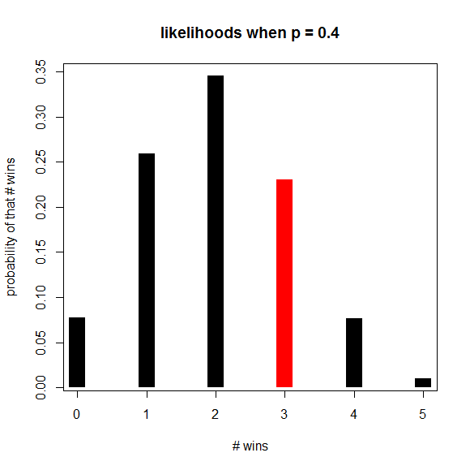
Likelihood distribution

Slide 38
Likelihood of winning 3 games, p=55%
To compute the likelihood
count the number of way to have a sequence of 3 wins and 2 losses
[,1] [,2] [,3] [,4] [,5]
[1,] "W" "W" "W" "L" "L"
[2,] "W" "W" "L" "W" "L"
[3,] "W" "W" "L" "L" "W"
[4,] "W" "L" "W" "W" "L"
[5,] "W" "L" "W" "L" "W"
[6,] "W" "L" "L" "W" "W"
[7,] "L" "W" "W" "W" "L"
[8,] "L" "W" "W" "L" "W"
[9,] "L" "W" "L" "W" "W"
[10,] "L" "L" "W" "W" "W“
Likelihood = 10 * 0.55 ^ 3 * (1-0.55) ^ 2 = 10 * 033690 = 0.33690

Slide 39
Likelihood
you play a 5 game series
40% chance of winning any game
What is the probability that your wins and losses will be in the following sequence?
W L L W W
0.40 * (1-0.40) * (1-0.40) * 0.40 * 0.40
= 0.40 ^ 3 * (1-0.40) ^ 2 = 0.02304

Slide 40
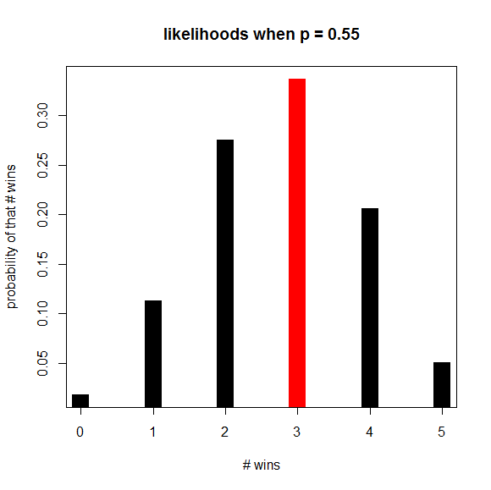
Likelihood distribution
Log(prob of 3 when p=.55/prob 3 when p=.40) =Log(0.33690 / 0.2304) = 0.379997

Slide 41
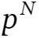
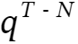
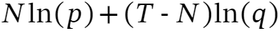
Model goodness-of-fit
p = expect percentage of exceptions; q=1-p
T = total number of days observed
N = number of exceptions
The likelihood of an exception occurring N times is
The likelihood of an exception is
The total likelihood is their product
The log likehood is therefore
This is also called the cross-entropy

Slide 42
Expected vs observed coverage
p = expect percentage of exceptions; q=1-p
T = total number of days observed
N = number of exceptions
P = N/T and Q = 1-P

Slide 43
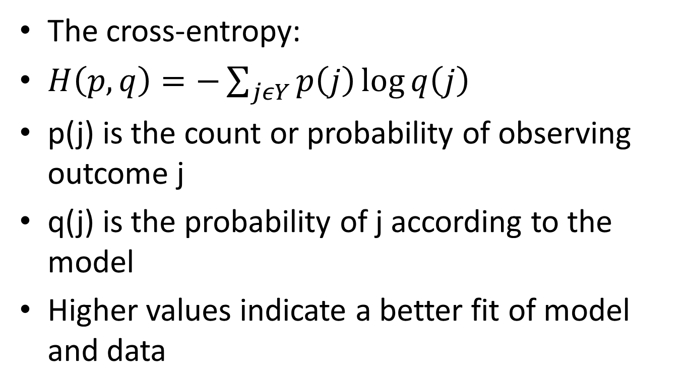
Cross entropy as a loss function
The cross-entropy:
$H\left(p,q\right)=−\sum_{jεY}{p\left(j\right)}\log{q\left(j\right)}$
p(j) is the count or probability of observing outcome j
q(j) is the probability of j according to the model
Higher values indicate a better fit of model and data

Slide 44
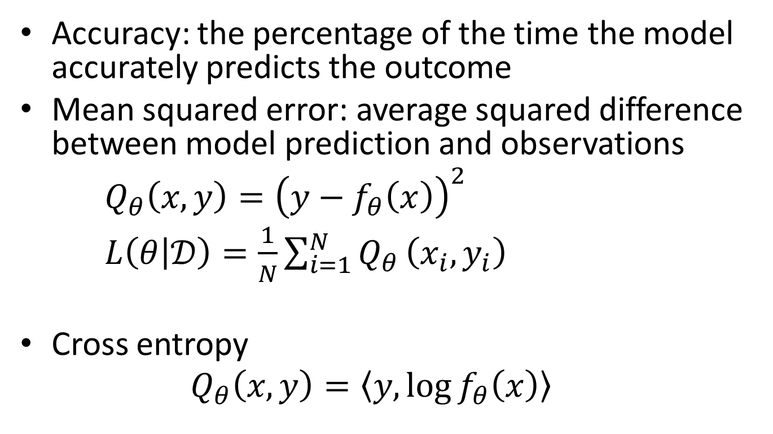
Some metrics to asses model quality
Accuracy: the percentage of the time the model accurately predicts the outcome
Mean squared error: average squared difference between model prediction and observations
$Q_{θ}\left(x,y\right)={\left(y−f_{θ}\left(x\right)\right)}^{2}$
$L\left(θ | 𝒟\right)=\frac{1}{N}\sum_{i=1}^{N}{Q_{θ}}\left(x_{i},y_{i}\right)$
Cross entropy
$$Q_{θ}\left(x,y\right)=\left\langle y, \log{f_{θ}\left(x\right)}\right\rangle$$

Slide 45
In class model presentation
Model and results are fully worked out on the internet
Problem should be financial
Url’s due as part of September 24 homework
You should not need to download data or run code to create your presentation
You are to do a critical review of what is done
5 minute presentation with PowerPoint slides
Practice your presentation beforehand
I will ask you questions about the data and modeling to assess your knowledge of the analysis

Slide 46
Answer these questions in your in-class model presentation
Problem to be solved by the model
Data description including
Source organization or individual
Time period and frequency or number of samples
Reason for original data collection
Variables used in the model
Detailed description of the model
The goodness-of-fit measure
Results
Was the modeling successful. If so, how can it be used?
url to the problem, model, and solutions
How could the analysis be done better

Slide 47
Some potential sources for ideas
https://neptune.ai/blog/predicting-stock-prices-using-machine-learning
https://aip.scitation.org/doi/abs/10.1063/5.0082035
https://www.kaggle.com/datasets?tags=11108-Finance
search for ‘stock price prediction using regression analysis’

Slide 48
Data types

Slide 49
How data is typically represented
Unstructured
Information is represented in its most natural form: intuitive for people, but not so much for computer
Structured
Information is well organized with a regular pattern: easy for computer to manipulate
“The patient came in complaining of chest pain, shortness of breath, and lingering headaches…smokes 2 packs a day…family history of heart disease…has been experiencing similar symptoms for the past 12 hours…”
Patient | Date Admitted
Joe Brown | 02/05/2014
Tom Smith | 03/12/2014
Jane Do | 07/31/2014

Slide 50
Data types
Numerical
Continuous
Radius, perimeter, weights
Discrete
Number of days, number of years
Categorical
Ordinal data: data that can be sorted or ordered
T-shirt size: XL > L > M > S
Nominal data: data that don’t imply any order
T-shirt color: red, yellow, blue

Slide 51
Questions to answer when eyeballing the data
What is the data about?
Data about breast cancer diagnosis
What is each field in the data?
#1: ID number
#2: Diagnosis: M = malignant, B = benign
#3 - #32: 30 real-valued features about different aspects of cell nuclei
Presented in the digitized image of a fine needle aspirate (FNA) of a breast mass
How big is the data?
569 rows of data
Any missing values?
No

Slide 52
There are many public available data sources
UCI machine learning repository
https://archive.ics.uci.edu/ml/datasets.html, Well organized, friendly for ML
U.S. Government’s open data
https://www.data.gov/, rich data sets, but less organized, not so friendly for ML
NYC OpenData
https://nycopendata.socrata.com/
A list of public data source maintained at Github
https://github.com/caesar0301/awesome-public-datasets, a good starting place to look for data
AWS public datasets
https://aws.amazon.com/datasets/
Kaggle datasets
https://www.kaggle.com/datasets

Slide 53
Univariate statistics

Slide 54
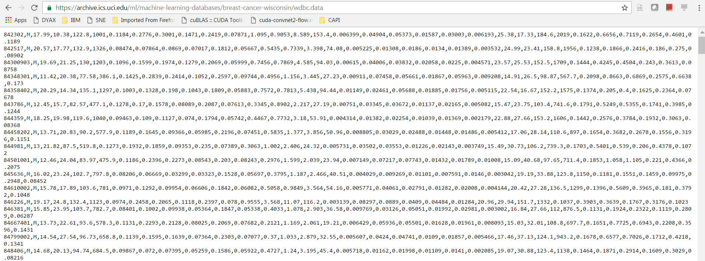
Importance of getting a real feel about data
Machine learning is all about getting to know about your data
Eyeballing the data is the first step and important one

Slide 55
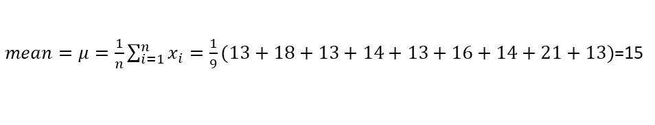
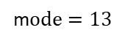
Univariate Analysis for continuous features: explore feature one by one
Understand the central tendency and spread of the variable
Can help detect outliers
Measures of central tendency in the list of numbers
Mean: the average value
Median: the middle value
Need to sort the number from smallest to largest before you can find the middle value
Mode: the value that occurs most often
If no number is repeated, there is no mode
Example list of data: $13, 18, 13, 14, 13, 16, 14, 21, 13$
$mean=μ=\frac{1}{n}\sum_{i=1}^{n}{x_{i}}=\frac{1}{9}(13+18+13+14+13+16+14+21+13)$=15
Sorted list of data: $13, 13, 13, 13, 14, 14, 16, 18, 21→median=14$
m$ode=13$

Slide 56
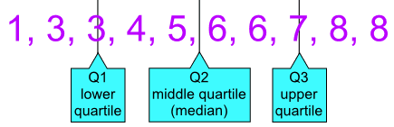
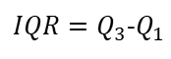
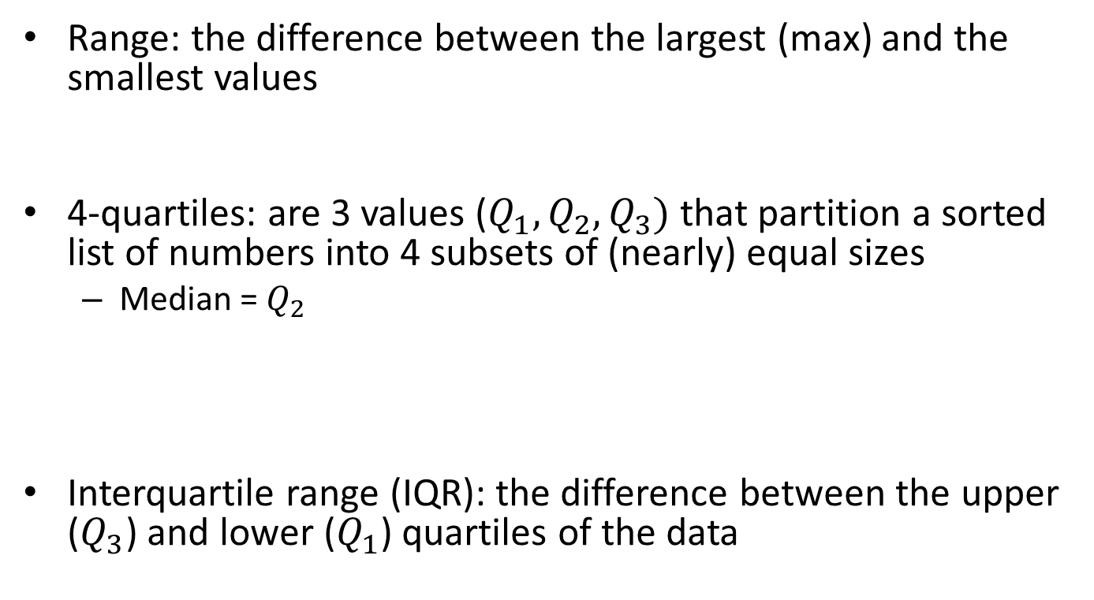
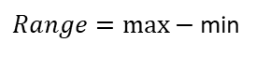
Measures of dispersion for a list of numbers
Range: the difference between the largest (max) and the smallest values
4-quartiles: are 3 values ($Q_{1},Q_{2},Q_{3})$ that partition a sorted list of numbers into 4 subsets of (nearly) equal sizes
Median = $Q_{2}$
Interquartile range (IQR): the difference between the upper ($Q_{3}$) and lower ($Q_{1}$) quartiles of the data
$Range=\max{−}$ min
$IQR=Q_{3}$-$Q_{1}$

Slide 57
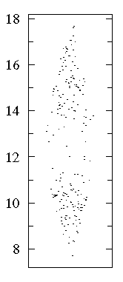
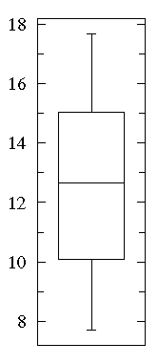
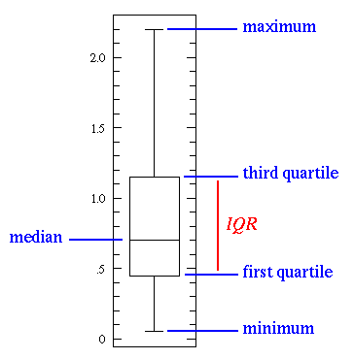
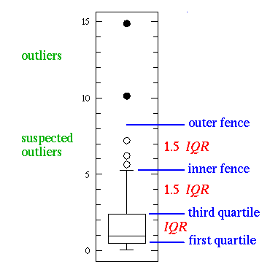
A boxplot
Boxplot is a way to depicting groups of numerical data through their quartiles
Also called box-and-whisker plot: whiskers indicating variability outside the upper and lower quartiles
[http://www.physics.csbsju.edu/stats/box2.html]

Slide 58
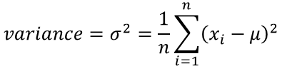
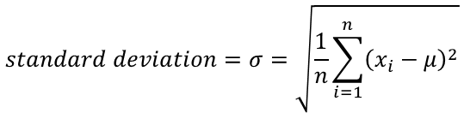
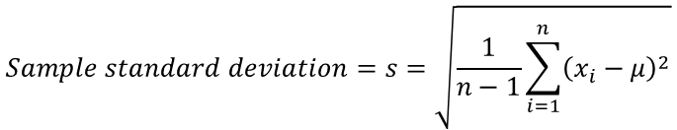
Measures of dispersion for a list of numbers
Variance: the average of the squared differences from the mean
Standard deviation: the square root of variance
When data is a sample of the whole population, the sample deviation is given by
Sam has 20 rose bushes (the population), but counted the flowers on 6 of them (the sample)
$$variance=σ^{2}=\frac{1}{n}\sum_{i=1}^{n}{{\left(x_{i}−μ\right)}^{2}}$$
$$standard deviation=σ=\sqrt{\frac{1}{n}\sum_{i=1}^{n}{{\left(x_{i}−μ\right)}^{2}}}$$
$$Sample standard deviation=s=\sqrt{\frac{1}{n−1}\sum_{i=1}^{n}{{\left(x_{i}−μ\right)}^{2}}}$$

Slide 59
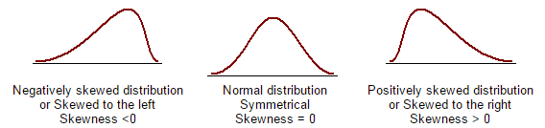
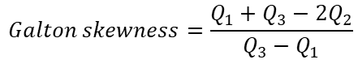

Measures of symmetry of a list of data
Skewness: a measure of symmetry, or more precisely, the lack of symmetry
A data set is symmetric if it looks the same to the left and right of the center point
There are many different formulas to measure skewness
Fisher-Pearson Coefficient of Skewness
$$g_{1}=\frac{1}{nσ^{3}}\sum_{i=1}^{n}{{\left(x_{i}−μ\right)}^{3}}$$
$$Galton skewness=\frac{Q_{1}+Q_{3}−2Q_{2}}{Q_{3}−Q_{1}}$$

Slide 60

Univariate analysis for categorical features
Use frequency table to understand the distribution of each category
Count or percentage of values under each category
[http://www.saedsayad.com/categorical_variables.htm]

Slide 61
Bivariate statistics

Slide 62


Bi-variate analysis for the relationship between two features
Continuous vs continuous features
Linear correlation: quantifies the strength of a linear relationship between two numerical features
The tendency for the values of one quantity to increase or decrease with the values of the second quantity
Correlation is always between -1 and 1
-1: perfect negative linear correlation
+1: perfect positive linear correlation
0: no linear correlation
$$covariance(x,y)=\frac{1}{n}\sum_{i=1}^{n}{\left(x_{i}−μ\right)\left(y_{i}−μ\right)}$$
$$correlation=ρ=\frac{covariance(x,y)}{σ_{x}σ_{y}}$$

Slide 63


Scatter plot for two numerical variables
Scatter plot matrix for dealing with many features
[http://www.saedsayad.com/numerical_numerical.htm]

Slide 64

Bi-variate analysis for categorical vs categorical data
Two-way frequency table
The rows representing the category of one feature, and the columns represent the categories of the other feature
Stacked column chart to show the two-way frequency table

Slide 65

Bi-variate analysis for categorical vs continuous features
Draw boxplots for each level of categorical features
[http://www.saedsayad.com/categorical_numerical.htm]

Slide 66
Data visualization

Slide 67

Visualization
Domestic sales were considerably and consistently higher than international.
Domestic sales trended upward over the year as a whole.
International sales, in contrast, remained relatively flat, with one glaring exception: they decreased sharply in August.
Domestic sales exhibited a cyclical pattern - up, up, down - that repeated itself on a quarterly basis.
[https://www.interaction-design.org/literature/book/the-encyclopedia-of-human-computer-interaction-2nd-ed/data-visualization-for-human-perception]

Slide 68

Visualization could make patterns in big data emerge quickly
The East Coast has a much greater population density
Minorities not evenly distributed with clearly defined regional groupings
[http://www.coopercenter.org/demographics/Racial-Dot-Map]
[https://www.techchange.org/2015/05/19/data-visualization-analysis-international-development/]

Slide 69

Visualization can capture relationships that are not quantitative
[https://www.interaction-design.org/literature/book/the-encyclopedia-of-human-computer-interaction-2nd-ed/data-visualization-for-human-perception]

Slide 70



Which one is a good representation of data?
[https://www.interaction-design.org/literature/book/the-encyclopedia-of-human-computer-interaction-2nd-ed/data-visualization-for-human-perception]

Slide 71

Word cloud: a graphical representation of word frequency

Slide 72


Slide 73


Slide 74
topics
Regression models: linear, polynomial, spline, tree, neural networks
Loss functions - MSD
Gradient descent – learning rate, stochastic, minibatch – comparison
R2 and adjusted R2
Cross-validation

Slide 75


Supervised learning functions
Linear regression: $f_{θ}\left(x\right)=θ^{T}x=\sum_{j=1}^{d}{θ^{(j)}x^{(j)}}$
where θ = vector of parameters, x=inputs variables
Non-linear regression: $f_{θ}\left(x\right)=\sum_{j=1}^{d}{θ^{(j)}g^{(j)}\left(x^{(j)}\right)}$
Where g() is a function

Slide 76

Loss Functions
$f_{θ}\left(x\right)=θ^{T}x$ model with y as the observed values
Quadratic loss function:
$$Q_{θ}\left(x,y\right)={\left(y−f_{θ}\left(x\right)\right)}^{2}$$
Empirical risk = loss function:
$$L\left(θ | 𝒟\right)=\frac{1}{N}\sum_{i=1}^{N}{Q_{θ}}\left(x_{i},y_{i}\right)$$

Slide 77
Optimization

Slide 78

Analytic solution for linear regression
$L\left(θ | 𝒟\right)=\frac{1}{N}\sum_{i=1}^{N}{{\left(y−xθ\right)}^{2}}$
This can be written
$$L\left(θ | 𝒟\right)=\frac{1}{N}{\left(Y−XΘ\right)}^{T}\left(Y−XΘ\right)$$
Where X, Y, and Θ are (NxM, Nx1, and Mx1) matrices
$∇L=\frac{2}{N}X^{T}\left(Y−XΘ\right)=0$ so
$X^{T}Y=X^{T}XΘ$ which implies ${\hat{Θ}=\left(X^{T}X\right)}^{−1}\left(X^{T}Y\right)$

Slide 79


Unconstrained optimization problem
$${\text{Minimize}}_{x∈S} f\left(x\right)$$
No fundamental difference between minimization and maximization problems
Linear vs nonlinear optimization
Constrained optimization can also be translated to unconstrained optimization by penalizing constraint violations in objective functions
Global minimum vs local minimal
Practically, we only look for a “reasonably” good local minimal
$${{\text{Maximize}}_{x∈S} f\left(x\right) ≡\text{Minimize}}_{x∈S} −f\left(x\right)$$

Slide 80

A necessary condition for a solution to be optimal
For optimization, a first-order necessary condition for a local minimizer is given by
$$∇f\left(x\right)=0$$

Slide 81


General optimization algorithm
Specify some initial guess of the solution x(0)
For k=0,1,…
If x(k) is optimal, stop
Determine an improved estimate of the solution
Most practical optimization algorithms follow this paradigm
It is an iterative algorithm
Why do we not just solve for the solution directly?
Except for simplest ones, most (practical) optimization does not have a closed form
The computed “solution” is only an approximation
Stop condition: typically when the value of x(k) and/or p(k) changes little
$$x\left(k+1\right)=x\left(k\right)+α\left(k\right)∗p\left(k\right)$$
$$α\left(k\right):a scalar for step length$$
$p\left(k\right)$: a search direction

Slide 82


Newton Method
Recall the first-order necessary condition for optimality
This typically ends up solving a system of nonlinear equations
$$∇f\left(x\right)=0$$
$$∇f\left(x\right)=g\left(x\right)=g(x_{1}{,x}_{2}\text{,…, }x_{n}\text{)=}\left[\begin{matrix}g_{1}\left(x_{1}{,x}_{2}\text{,…, }x_{n}\right) \\ \begin{matrix}g_{2}\left(x_{1}{,x}_{2}\text{,…, }x_{n}\right) \\ ⋮\end{matrix} \\ g_{n}\left(x_{1}{,x}_{2}\text{,…, }x_{n}\right)\end{matrix}\right]=0$$
Taylor series approximation for $g\left(x\right): g\left(x\left(k\right)+p(k)\right)≈g\left(x\left(k\right)\right)+∇g\left(x\left(k\right)\right)p(k)$
Solve for the Newton direction $p(k)$: $g\left(x\left(k\right)\right)+∇g\left(x\left(k\right)\right)p(k)=0 \underset{→}{\text{yields}} p(k)=−{∇g\left(x\left(k\right)\right)}^{−1}g\left(x\left(k\right)\right)$
The iterative solution is given by: $x\left(k+1\right)=x\left(k\right)+α\left(k\right)∗p\left(k\right)=x\left(k\right)−α\left(k\right)∗{∇g\left(x\left(k\right)\right)}^{−1}g\left(x\left(k\right)\right)$

Slide 83

Classic Newton’s search direction
In the classical Newton method, the search direction is given by
Which may not necessary yield a good descent direction
When Hessian is indefinite, one possible solution is to replace the Hessian with some related positive definite matrix
Characteristics of classic Newton’s methods
Good convergence: “quadratic” rate of convergence
Bad computation cost: Hessian and its inverse
$$∇f\left(x\right)=g\left(x\right)=0\underset{→}{\text{yields}}p\left(k\right)=−{∇g\left(x\left(k\right)\right)}^{−1}g\left(x\left(k\right)\right)=−{\left[∇^{2}f\left(x\left(k\right)\right)\right]}^{−1}∇f\left(x\left(k\right)\right)$$
$${∇f\left(x\left(k\right)\right)}^{T}p\left(k\right)<0⇔−{{∇f\left(x\left(k\right)\right)}^{T}\left[∇^{2}f\left(x\left(k\right)\right)\right]}^{−1}∇f\left(x\left(k\right)\right)<0$$
$⇔{{∇f\left(x\left(k\right)\right)}^{T}\left[∇^{2}f\left(x\left(k\right)\right)\right]}^{−1}∇f\left(x\left(k\right)\right)>0$
$⇔$ Hessian $∇^{2}f\left(x\left(k\right)\right)$ is positive definite

Slide 84




Hand waving theoretic guarantees
To ensure the “general optimization algorithm” work, we require a number of conditions to be satisfied
The search direction is a descent direction (at every step)
Search step sequences needs to guarantee “global convergence”, i.e., convergence to a stationary point from any starting point
Roughly speaking, the new estimate of the solution not only needs to decrease, but should “sufficiently” decrease, while the step length should not be “too small”
One most widely used line search method: backtracking the step length to satisfy an Armijo condition:
$$x\left(k+1\right)=x\left(k\right)+α\left(k\right)∗p\left(k\right)$$
$$α\left(k\right):a scalar for step length$$
$p\left(k\right)$: a search direction
$$∇f\left(x\left(k\right)\right)p(k)<0$$
Taylor series approximation for $f\left(x\right): f\left(x\left(k\right)+p(k)\right)≈f\left(x\left(k\right)\right)+∇f\left(x\left(k\right)\right)p(k)$
$f\left(x\left(k\right)+α\left(k\right)∗p\left(k\right)\right)≤f\left(x\left(k\right)\right)+μα(k)∇f\left(x\left(k\right)\right)p(k)$, where $0<μ<1$
$α\left(k\right)$: 1, $\frac{1}{2},\frac{1}{4},\frac{1}{8},…,2^{−i},…$

Slide 85

Armijo condition
Given an objective function f(x) and its gradient ∇f(x),
the goal is to find a step size α such that moving in the direction of the negative gradient leads to a significant decrease in f.
The Armijo condition ensures that the function value decreases sufficiently as follows:
$$f\left(x−α∇f\left(x\right)\right)≤f\left(x\right)−cα{⟦∇f\left(x\right)⟧}^{2}$$
With $c∈\left(0,1\right)$. Commonly $c={10}^{−4}$

Slide 86
Why use the Armijo condition?
Avoid too small steps: It prevents taking excessively small steps that could lead to very slow convergence.
Avoid too large steps: It ensures the step size isn't too large, which could cause overshooting and instability in the optimization process.
Adaptive step size: The Armijo condition is often used in line search methods to adaptively choose the step size. If a step size does not satisfy the condition, it can be reduced iteratively until it does.

Slide 87
But
Searching for the optimal α is time consuming
The search needs to be computed sequentially as the gradient changes as the search proceeds
There may be millions of operations to recomputing f(x) for all values of x

Slide 88





Steepest descent method vs Gradient descent method
The simplest Newton-type methods with a descent direction defined as
This is indeed a descent direction
Characteristics
Low computation cost
Slow rate of convergence: linear
Step length to update search
Steepest descent
Gradient descent
$$p\left(k\right)=−∇f\left(x\left(k\right)\right)$$
$$∇f\left(x\left(k\right)\right)p\left(k\right)=−∇f\left(x\left(k\right)\right)∇f\left(x\left(k\right)\right)<0$$
$$x\left(k+1\right)=x\left(k\right)+α\left(k\right)∗p\left(k\right)$$
$$a\left(k\right)={argmin}_{a\left(k\right)>0}\left(f\left(x\left(k\right)+α\left(k\right)∗p\left(k\right)\right)\right)$$
$a\left(k\right)>0$of some sort

Slide 89



Quasi-Newton Methods
Somewhere in between classic Newton and Gradient descent methods
Recall in classic Newton, the descent direction is define by
Quasi-Newton = instead of computing the Hessian, we approximate it
[something] represents an update to the old approximation “update formula”
Imposing conditions on B(k), typically the properties of Hessian
Symmetry
Positive definite
$$∇f\left(x\right)=g\left(x\right)=0\underset{→}{\text{yields}}p\left(k\right)=−{∇g\left(x\left(k\right)\right)}^{−1}g\left(x\left(k\right)\right)=−{\left[∇^{2}f\left(x\left(k\right)\right)\right]}^{−1}∇f\left(x\left(k\right)\right)$$
$$\left[∇^{2}f\left(x\left(k\right)\right)\right]p\left(k\right)=−∇f\left(x\left(k\right)\right)$$
$$B\left(k\right)p\left(k\right)=−∇f\left(x\left(k\right)\right)$$
$B\left(k+1\right)=B\left(k\right)+$ [something]
The BFGS update formula: [something] = $\frac{\left(B\left(k\right)s(k)\right){\left(B\left(k\right)s(k)\right)}^{T}}{{s(k)}^{T}B\left(k\right)s(k)}+\frac{y(k){y(k)}^{T}}{{y(k)}^{T}s(k)}$
where $s\left(k\right)=x\left(k+1\right)−x\left(k\right), y\left(k\right)=∇f\left(x\left(k+1\right)\right)−∇f\left(x\left(k\right)\right)$

Slide 90




Objective function in a special form of a sum
Most machine learning problems consider an objective in a form of a sum
The gradient computation depends on the size of data set N
When N becomes large (which is typically the case, unfortunately, for Big Data applications), the computation cost becomes too high
Search direction needs to be updated for every iteration
$$f\left(x\right)=\frac{1}{N}\sum_{i=1}^{N}{f_{i}(x)}$$
where $f_{i}(x)$ is typically related to the $i$–th observation in the data set
$$∇f\left(x\right)=\frac{1}{N}\sum_{i=1}^{N}{{∇f}_{i}(x)}$$
$$x\left(k+1\right)=x\left(k\right)+α\left(k\right)∗p\left(k\right)$$
$$B\left(k\right)p\left(k\right)=−∇f\left(x\left(k\right)\right)$$

Slide 91



Stochastic gradient descent (SGD)
Instead of using all data set N to compute the standard (or “batch”) gradient descent, SGD uses samples of a subset of N summand functions at every iteration
“Stochastic” means the algorithm “randomly” samples the data at every iteration
This is also called mini-batch SGD
On-line (confusedly, also called stochastic) gradient descent uses one sample at a time
$$∇f\left(x\right)=\frac{1}{N}\sum_{i=1}^{N}{{∇f}_{i}(x)≈\frac{1}{N_{m}}\sum_{i=1}^{N_{m}}{{∇f}_{i}(x)}}$$
with $N_{m}≪N$
$∇f\left(x\right)≈{∇f}_{i}(x$)
with $N_{m}≪N$

Slide 92




Mini-summary of different ways of obtaining search direction
Classic Newton
Gradient descent
Stochastic gradient descent (when objective in a summation form)
On-line gradient descent
Quasi-Newton
$$p\left(k\right)=−{\left[∇^{2}f\left(x\left(k\right)\right)\right]}^{−1}∇f\left(x\left(k\right)\right)$$
$$p\left(k\right)=−∇f\left(x\left(k\right)\right)$$
$$∇f\left(x\right)=\frac{1}{N}\sum_{i=1}^{N}{{∇f}_{i}(x)≈\frac{1}{N_{m}}\sum_{i=1}^{N_{m}}{{∇f}_{i}(x)}}$$
$∇f\left(x\right)≈{∇f}_{i}(x$)
$$B\left(k\right)p\left(k\right)=−∇f\left(x\left(k\right)\right), where B\left(k\right) approximates Hessian$$

Slide 93






Finite difference for derivative estimation
It refers to numerical estimation of derivatives using functional values
For one dimensional case
For multi-dimensional case, this can be done similarly
$$f^{′}\left(x\right)=\lim_{h→0}{\frac{f\left(x+h\right)−f(x)}{h}}≈\frac{f\left(x+h\right)−f(x)}{h}$$
$$f^{′}\left(x\right)≈\frac{f\left(x+h\right)−f(x−h)}{2h}$$
$$f^{′′}\left(x\right)≈\frac{f\left(x+h\right)−2f\left(x\right)+f(x−h)}{h^{2}}$$
$${\left[∇f(x)\right]}_{i}≈\frac{f\left(x+he_{i}\right)−f(x)}{h}$$
$$e_{i}={\left[\begin{matrix}0 & ⋯ & \begin{matrix}0 & 1 & \begin{matrix}0 & \begin{matrix}⋯ & 0\end{matrix}\end{matrix}\end{matrix}\end{matrix}\right]}^{T}$$
$${\left[∇^{2}f(x)\right]}_{ij}=\frac{∂^{2}f(x)}{∂x_{i}∂x_{j}}≈\frac{{\left[∇f\left(x+he_{j}\right)−∇f(x)\right]}_{i}}{h}$$

Slide 94
Automatic differentiation
It refers to numerical estimation of derivatives of functions (typically) specified by a computer program
It exploits a few factors of a computer program
Every computer program, no matter how complicated, executes a sequence of elementary arithmetic operations and elementary functions
Operations: addition, subtraction, multiplication, division, etc.
Elementary functions: exp, log, sin, cos, etc.
By applying the chain rule repeatedly to these operations, derivatives of arbitrary order can be computed
Automatically
Accurately to working precision, and
Using a small constant factor more arithmetic operations than the original program
There are software packages that can do this automatically (no pun intended) for you

Slide 95





An automatic differentiation example
$$f\left(x_{1},x_{2},x_{3}\right)=x_{1}x_{2}x_{3}+e^{2x_{1}^{2}}$$
Decompose function evaluation into a sequence of simple calculation, each involving only one or two variables
$$\frac{∂f}{∂x_{9}}=1$$
$$\frac{∂f}{∂x_{6}}=\frac{∂f}{∂x_{9}}\frac{∂x_{9}}{∂x_{6}}=1×1=1$$
$$\frac{∂f}{∂x_{8}}=\frac{∂f}{∂x_{9}}\frac{∂x_{9}}{∂x_{8}}=1×1=1$$
$$\frac{∂f}{∂x_{5}}=\frac{∂f}{∂x_{6}}\frac{∂x_{6}}{∂x_{5}}=1×x_{3}=x_{3}$$
$$\frac{∂f}{∂x_{7}}=\frac{∂f}{∂x_{8}}\frac{∂x_{8}}{∂x_{7}}=1×e^{x_{7}}=e^{x_{7}}$$
$$x_{5}=x_{1}x_{2}$$
$$x_{6}=x_{5}x_{3}$$
$$x_{7}=2x_{1}^{2}$$
$$x_{8}=e^{x_{7}}$$
$$x_{9}=x_{6}+x_{8}$$
$$\frac{∂f}{∂x_{3}}=\frac{∂f}{∂x_{6}}\frac{∂x_{6}}{∂x_{3}}=1×x_{5}=x_{5}$$
$$\frac{∂f}{∂x_{2}}=\frac{∂f}{∂x_{5}}\frac{∂x_{5}}{∂x_{2}}=x_{3}×x_{1}=x_{3}x_{1}$$
$\frac{∂f}{∂x_{1}}=\frac{∂f}{∂x_{7}}\frac{∂x_{7}}{∂x_{1}}+\frac{∂f}{∂x_{5}}\frac{∂x_{5}}{∂x_{1}}=x_{2}x_{3}$+4$x_{1}e^{x_{7}}$
$${f\left(x_{1},x_{2},x_{3}\right)=x}_{9}$$

Slide 96

Optimization when derivatives are not required
Some practical problems are difficult or impossible to calculate derivatives
All previous Newton-like methods required at least derivatives (gradients)
A direct search method = systematic “trial-and-error”
E.g., the multidirectional search method
This requires more functional evaluations
[“On The Convergence Of The Multidirectional Search Algorithm”, V. Torczon, 1991]

Slide 97


Function minimization
Reference: https://en.wikipedia.org/wiki/Nonlinear_conjugate_gradient_method

Slide 98
Learning rate concepts
Computing the distance to the minimum is
Computationally expensive
Requires further iterations at the minimum
Long steps are good at the start, but can cause problems as one nears the minimum point
Short steps are good near the minimum, but may take a long time to find the minimum

Slide 99
Adam algorithm concepts
Adaptive Learning Rate: Adam adjusts the learning rate for each parameter individually, making it suitable for problems with sparse gradients or when the learning rates differ across parameters.
Momentum: Adam incorporates momentum by keeping an exponentially decaying average of past gradients, which helps smooth the update steps and speeds up convergence.

Slide 100

Adam algorithm
Momentum: Average of past gradient
$$m_{t}=β_{1}m_{t−1}+\left(1−β_{1}\right)g_{t}$$
Adaptive learning rate:
$$v_{t}=β_{2}v_{t−1}+\left(1−β_{2}\right)g_{t}^{2}$$
Bias correction
${\hat{m}}_{t}=\frac{m_{t}}{1−β_{1}^{t}}$, ${\hat{v}}_{t}=\frac{v_{t}}{1−β_{2}^{t}}$
Parameter update
$$w_{t}=w_{t−1}−α\frac{{\hat{m}}_{t}}{\sqrt{{\hat{v}}_{t}}+ε}$$

